Slide 1

PYFAANG Stock Analysis
Pei-Ju Wu (Emily)
UC Berkeley Bootcamp

Slide 2
Introduction & objectives
Analyze FAANG stock data from 2012 to 2022. Gain insights into price trends, trading volumes, and market capitalization. Compare performance to the S&P 500 index. Provide investment recommendations based on risk profiles.

Slide 3

Data sources & DATA PROCESS & VISUALIZATION
YAHOO-FIN PYTHON OPEN-SOURCE LIBRARY
ALPHA VANTAGE API
PANDAS
MATPLOTLIB
SEABORN

Slide 4
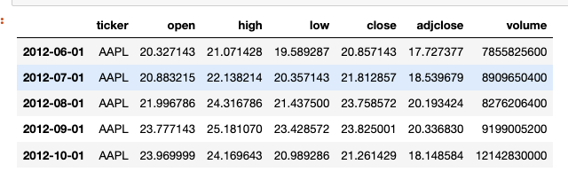
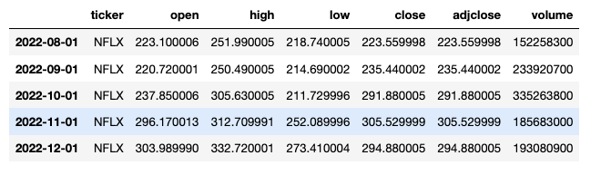
DATA FECTHING
The FAANG stock data covers 10 years on a monthly basis, starting from June 1, 2012, after the IPO of Meta in May 2012.
It includes monthly open, close, high, low prices, adjusted close prices, and trading volume.

Slide 5
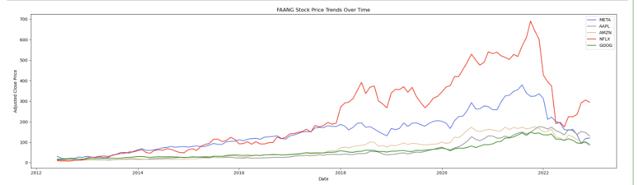
Price trends
The trend for FAANG companies shows a consistent increase in stock prices over the analyzed period.

Slide 6
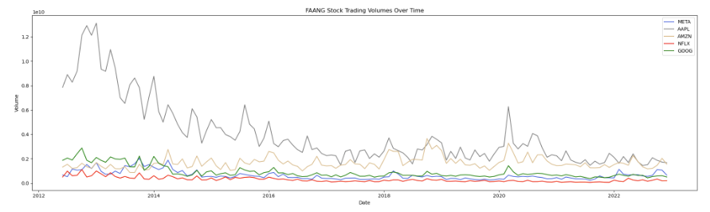
Trading volumes
Overall, there was a decrease in the trading volume trend. However, in the years of 2018 and 2020, there was a notable increase in trading volumes.

Slide 7
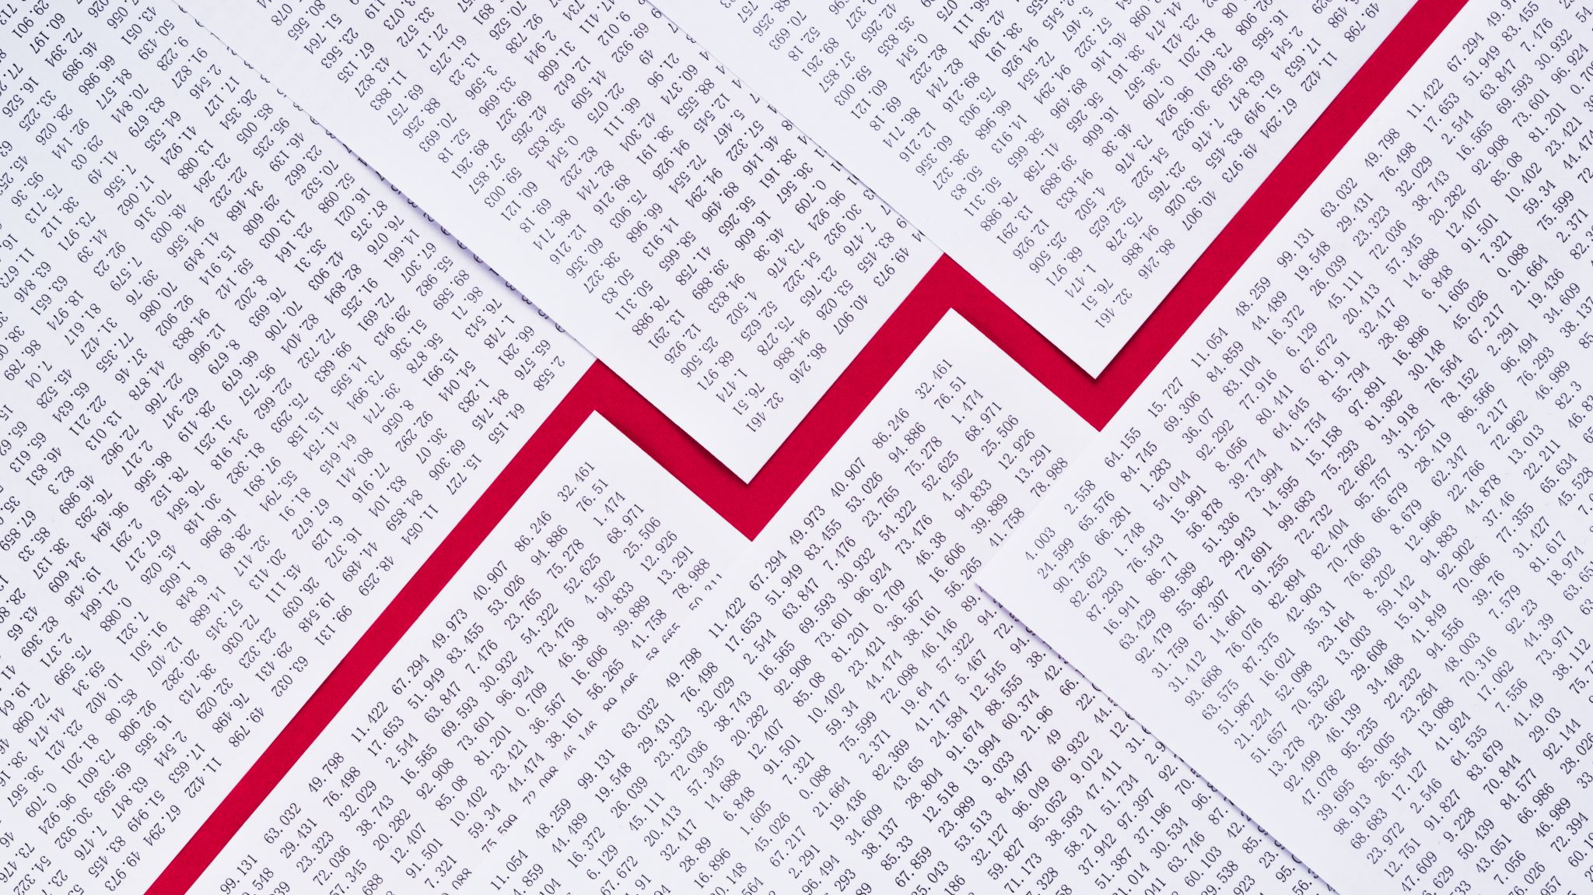
The Impact of COVID on the Stock Performance of FAANG Companies

Slide 8
Focus on
Price Trends
Trading Volumes
Comparison of Market Cap
Pre-pandemic
During pandemic
Post-pandemic

Slide 9
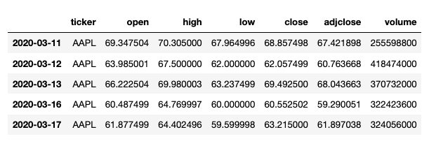
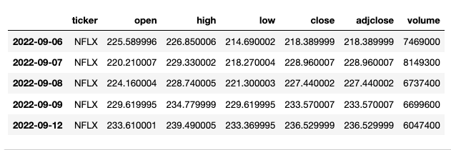
Covid dataset
The COVID period from March 11, 2020, to September 12, 2022, is represented using daily intervals to analyze the FAANG stock prices.

Slide 10
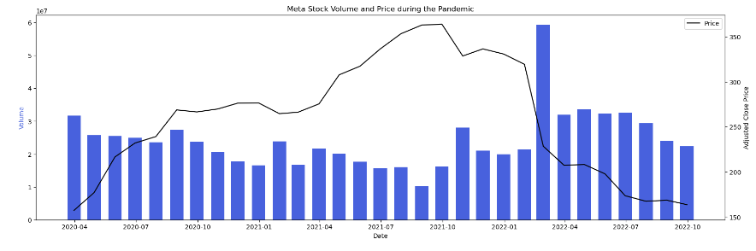

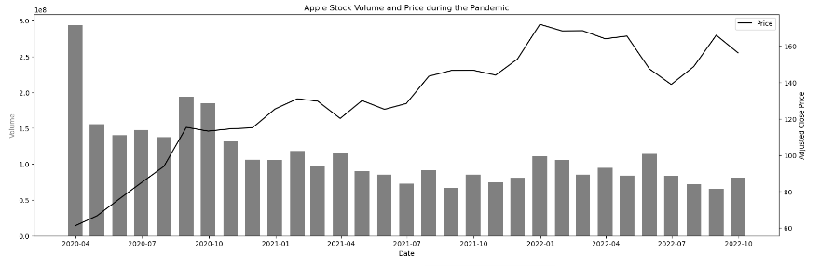

PRICE TRENDS & TRADING VOLUMES

Slide 11
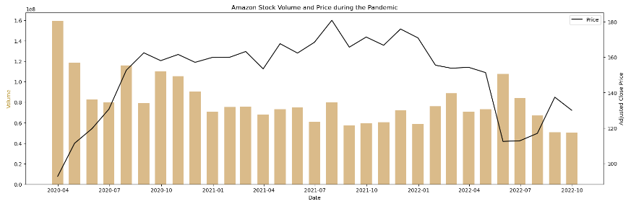


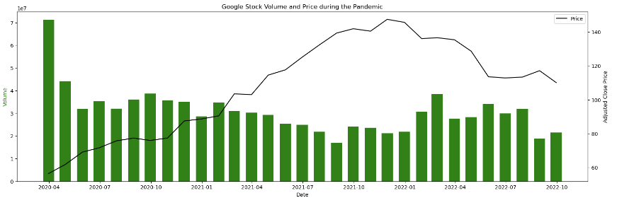
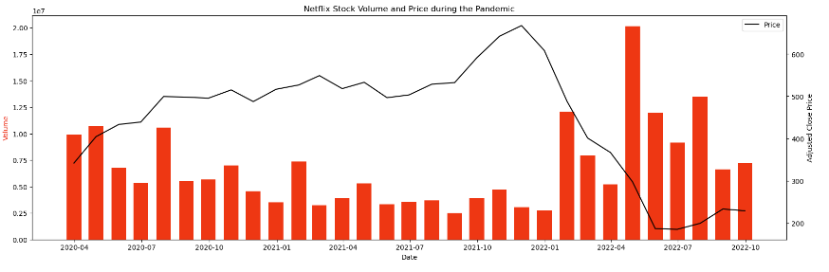
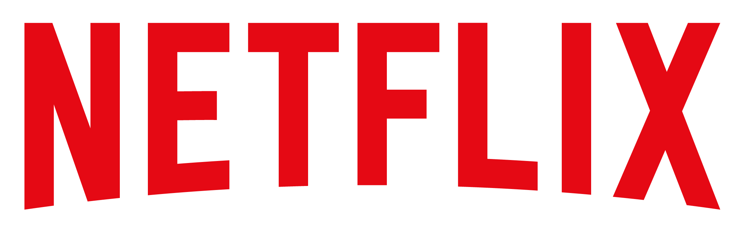
FAANG stocks initially dropped during the pandemic, except for Netflix. They later recovered, reflecting FAANG regained investors’ confidence.

Slide 12
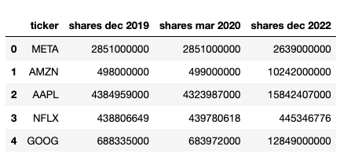
Share Data
Outstanding share data:
Pre-Pandemic (December 2019)
Pandemic (March 2020)
Post-Pandemic (December 2022)

Slide 13
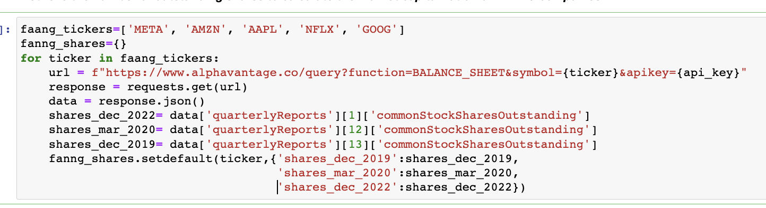
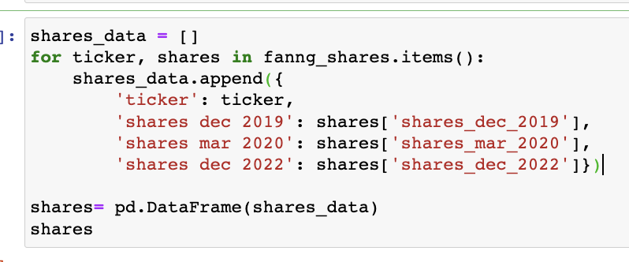
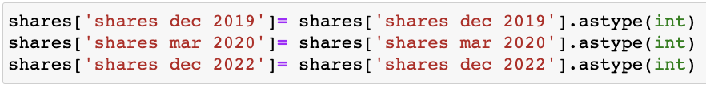
Using api and dictionary setdefalult function to collect outstanding share data from json file
- Using list to append share data in order to turn data into a pandas DataFrame
- Casting data type to integer

Slide 14
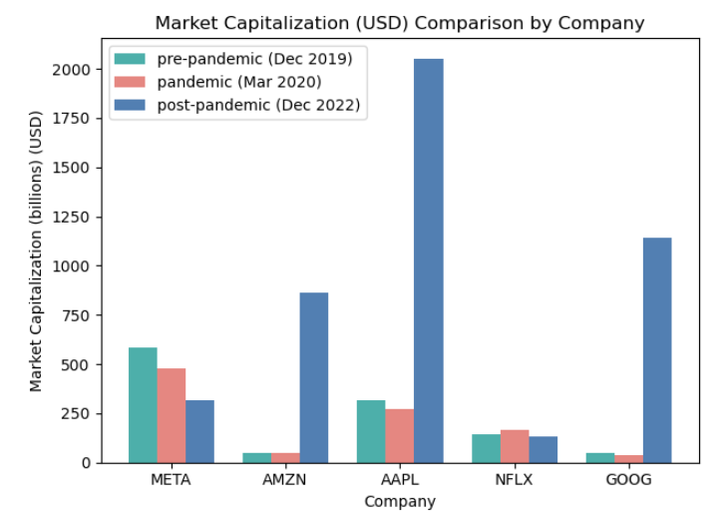
Calculating & comparing Market Cap
Multiplying Share Data with Stock Prices
During COVID Netflix Holds Strong
Amazon, Google, and Apple Stage Impressive Recovery in Post-COVID Era

Slide 15
Comparison of S&P 500 Index vs FAANG Stocks

Slide 16
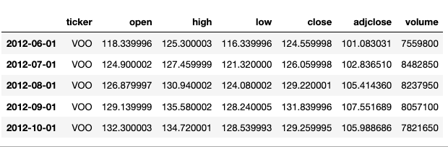
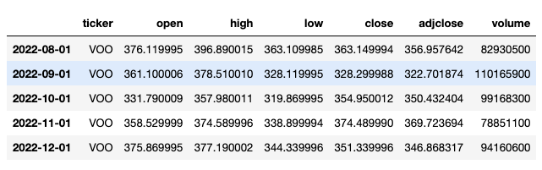
FECTCHING SP500 INDEX DATA
Utilizing the same interval and time span as the FAANG company data, the VOO ETF closely mirrors the performance of the S&P 500 Index.

Slide 17
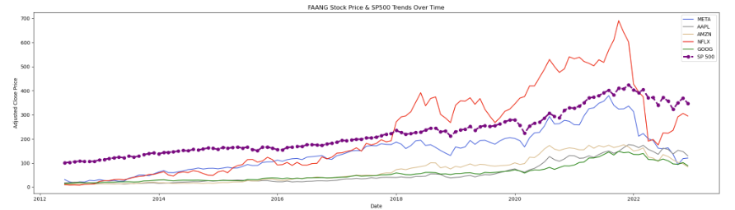
PRICE TRENDS COMPARSION
Most FAANG companies displayed a similar trend, aligning with the S&P 500 Index.

Slide 18
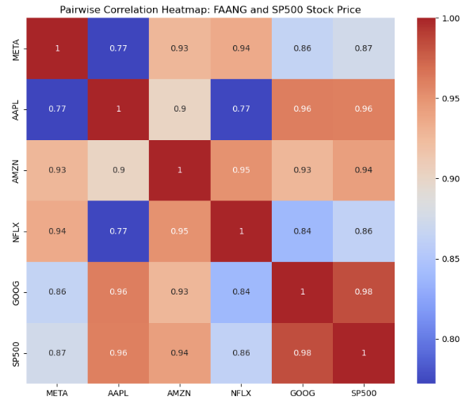
Correlation heatmap
Heatmap shows positive correlation between FAANG stocks and S&P 500, indicating a close relationship.

Slide 19
EXECUTIVE Summary
FAANG stocks demonstrate consistent price increase, making them attractive investments.
Apple, Google, and Amazon are relatively stable, while Netflix and Meta show higher volatility.
FAANG stocks offer long-term growth opportunities with different levels of risk and potential rewards based on individual preferences.

Slide 20
NEXT STEP
Utilizing Machine Learning Algorithms for Stock Price Prediction

Slide 21
THANK YOU

